Slide 1
One Table CRUD in ASP.NET with coding

Slide 2
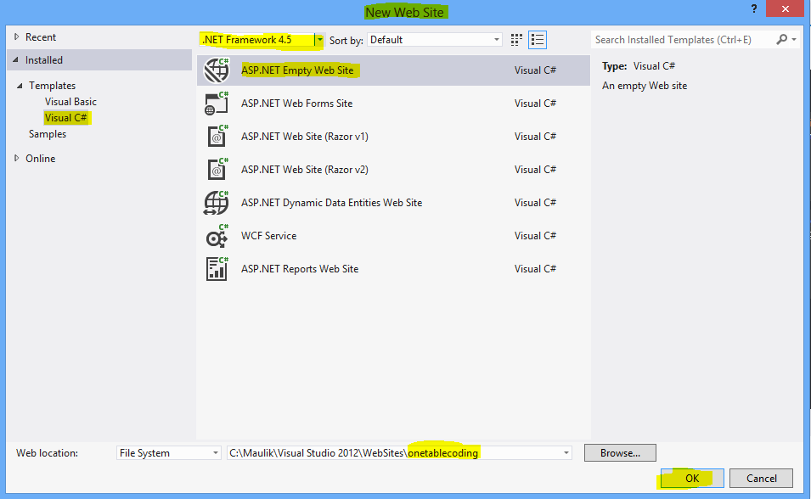
Create new ASP.NET empty web site
(1)
(3)
(2)
(4)
(5)

Slide 3
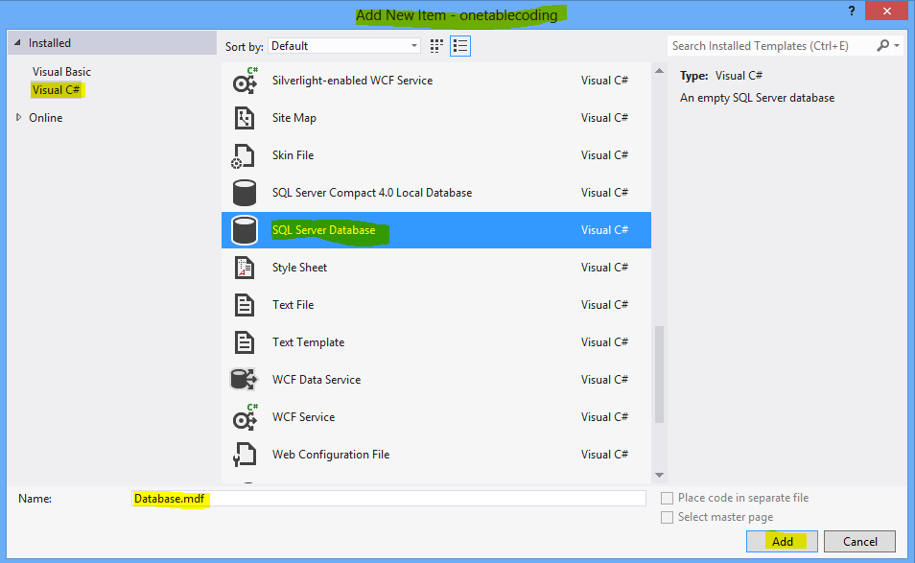
Create Database
(1)
(2)
(3)
(4)
(5)

Slide 4
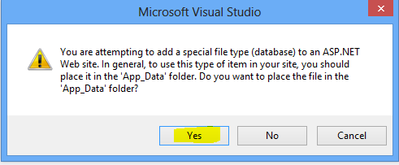
This popup is asking that do you want to add database in your .NET site?
So click on YES

Slide 5
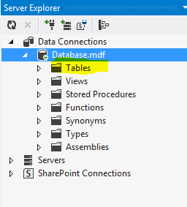
Right click on table and add new table.

Slide 6
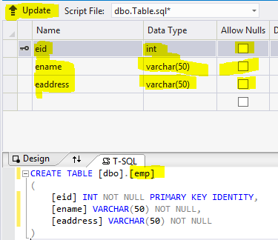
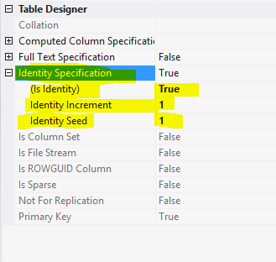
(5)
(1)
(4)
(3)
Add 3 field like above, give the name to the table, for eid in properties panel make auto increment and then click on update.

Slide 7
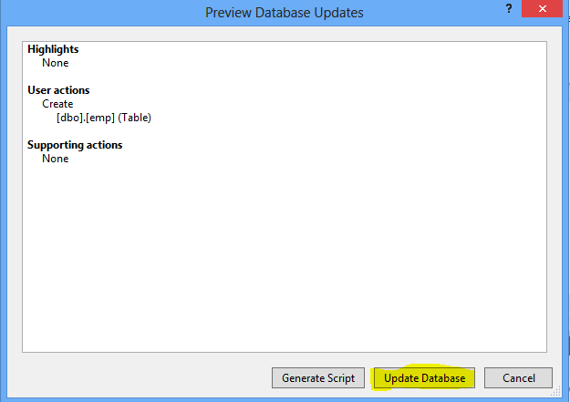
Click on Update Database for add table in database

Slide 8
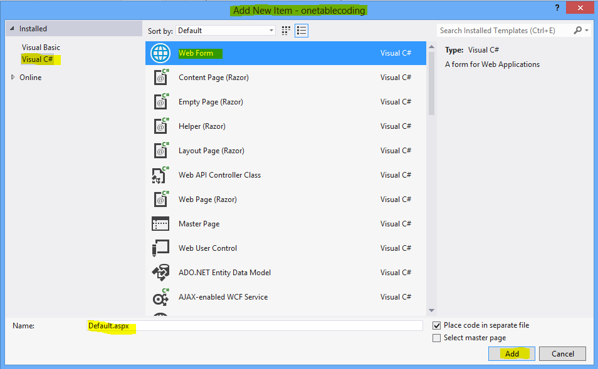
Add web form in site

Slide 9
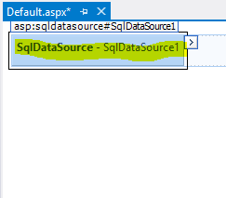
Add SqlDataSource in web form in design tab so can create connectionstring which help to connect database and web from.
Select this tag and select configuration

Slide 10
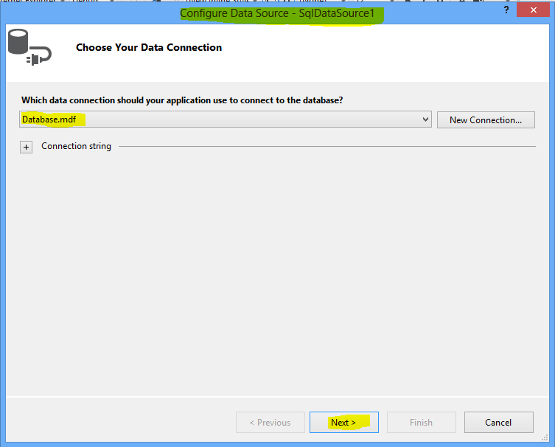
Select your database you want to connect with your web form

Slide 11
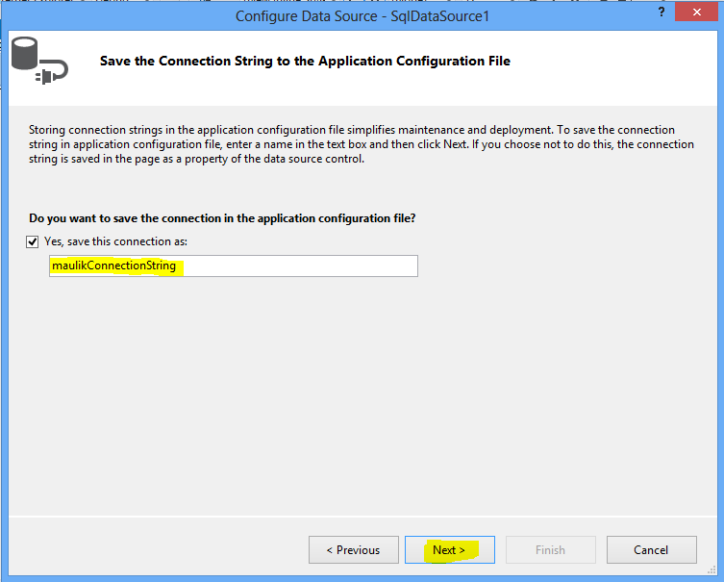
Give name to connectionString

Slide 12
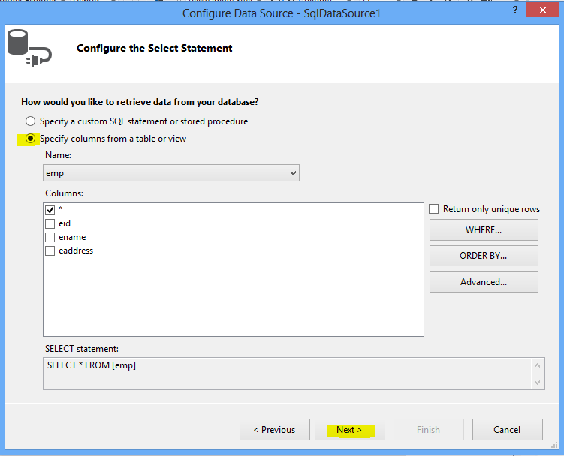

Slide 13
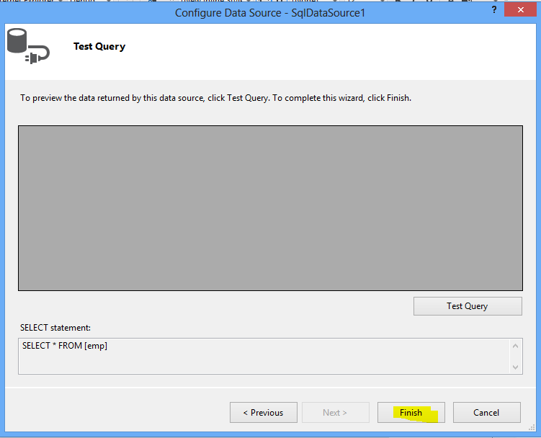

Slide 14
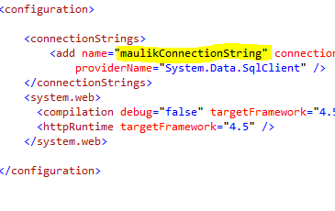
ConnectionString is now created in web.config file

Slide 15
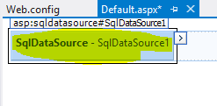
Delete this sqldataSource because this is use to create connectionString and it is created in web.config file

Slide 16
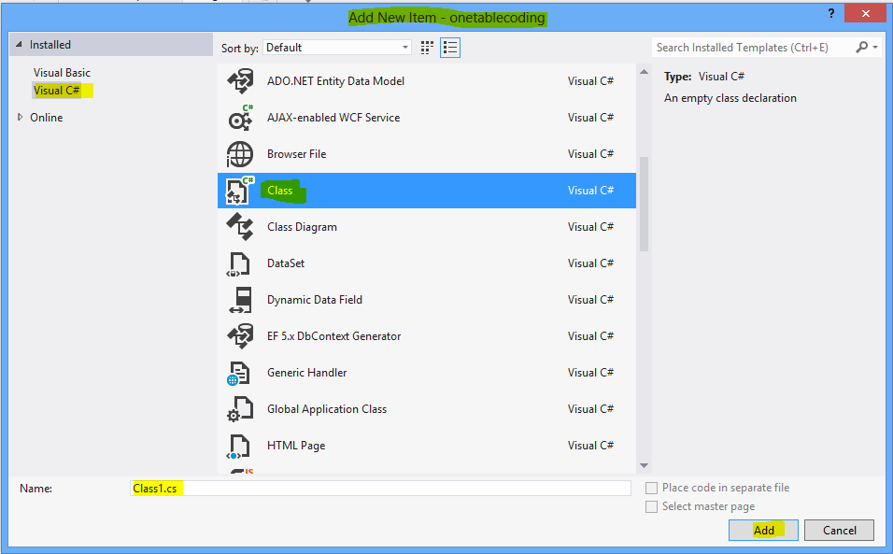
Add new class

Slide 17
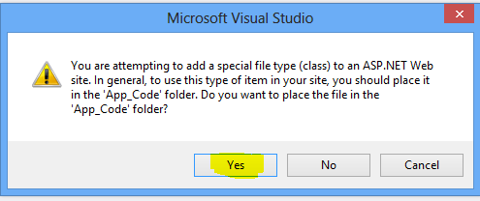
This popup is asking that do you want to add class in your .NET site?
So click on YES

Slide 18
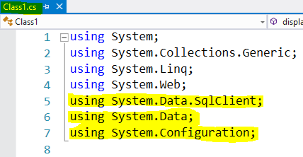
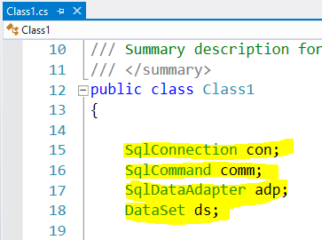
Add three namespace in class1.cs
Create reference of these four class in class1

Slide 19
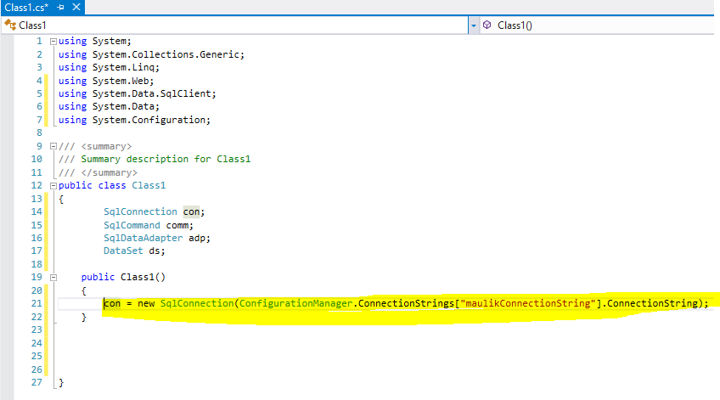
Call connectionString in calss1

Slide 20
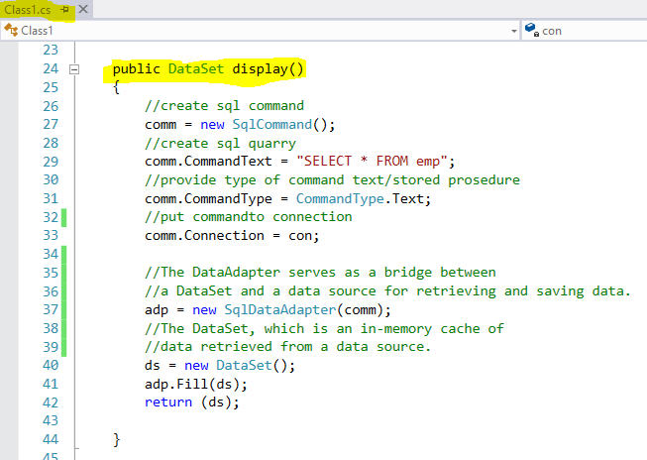
Create method for Select quarry in Class class1

Slide 21
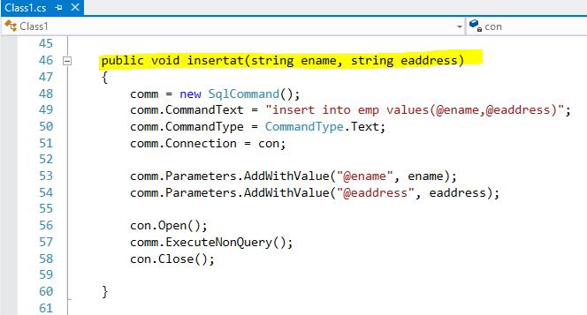
Create method for Insert quarry in Class class1

Slide 22
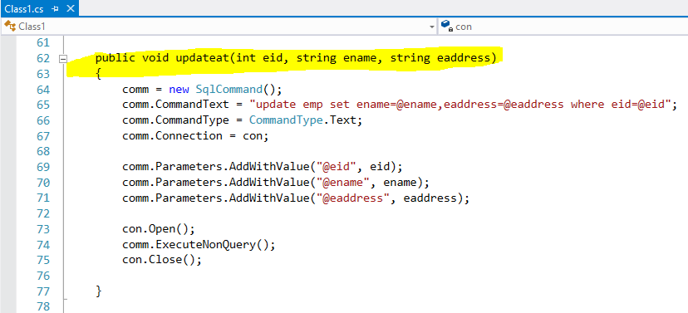
Create method for Update quarry in Class class1

Slide 23
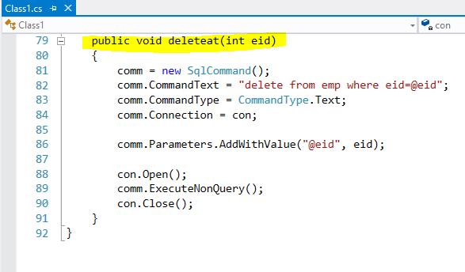
Create method for Delete quarry in Class class1

Slide 24
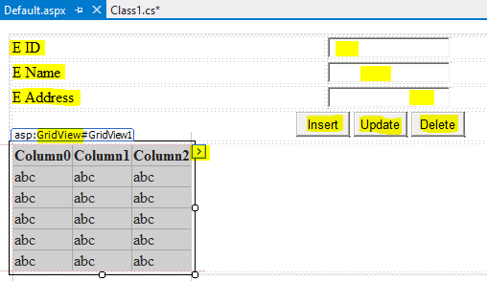
(1) Take three label, three textbox, three button and one Gridview
(2) Click here and go to edit columns..

Slide 25
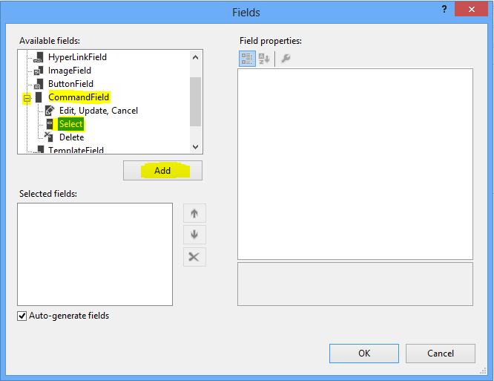
Expand CommandField
>click on Select
>click on Add

Slide 26
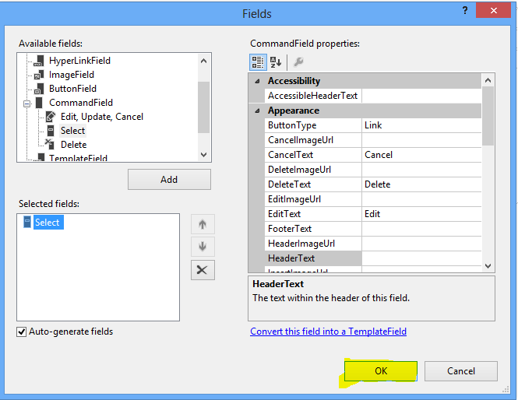

Slide 27
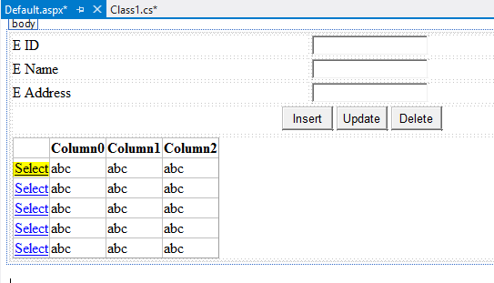
Now change is now seen.
Select column is added in grideview

Slide 28
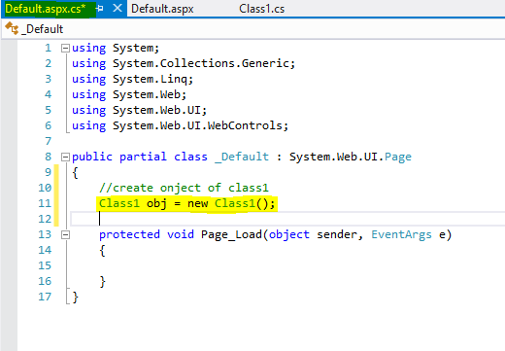
Create object of class1 in code behind of web page so that can access all the methods inside the web page.

Slide 29
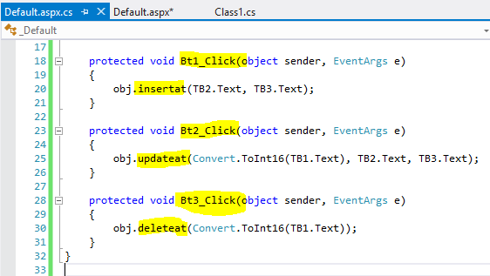
Fire buttons event and call methods of class1 for insert, update and delete operations.

Slide 30
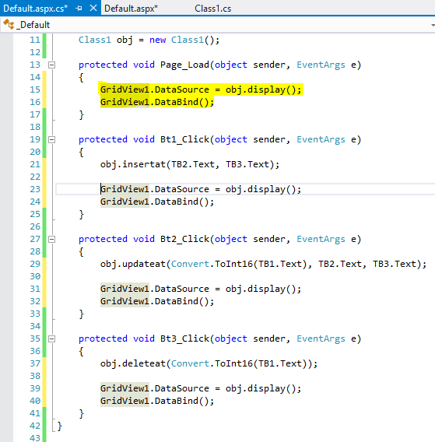
Bind data of gridview call into all the events as in screen

Slide 31
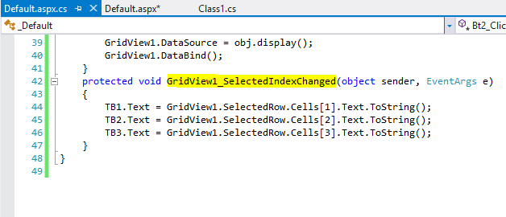
Fire SelectionIndexChanged event of gridview, bind particular data of grideview with textbox when gridview's data is selected
Save all the files and run website

Slide 32
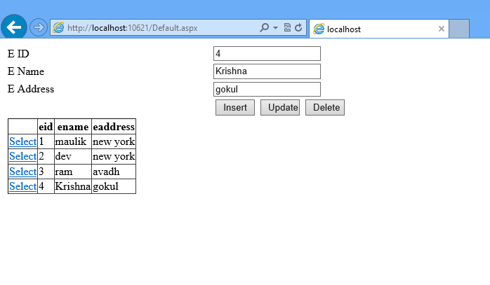
Output:-
Perform all the operation

